Slide 1
Artificial intelligence
Logical Agents

Slide 2
Notice
Presentation slides will be available for download along with the recording of this review session.
You are free to take pictures regardless if you’d like.

Slide 3
DISCLAIMER
I have tried to pull all information from the slides, the textbook, and other authorized resources, but I cannot guarantee the veracity of any information in the slides hereafter.
See presentation notes for sources (chapter pages are for 4th ed.)

Slide 4
Outline
Knowledge-based agents
Logic
Propositional logic
Entailment concepts & inference rules
Advanced inference algorithms
Notes:
Chapter07 slide 2

Slide 5
KB Agents
Unrelated to KGB agents, I promise

Slide 6
Knowledge-Based Agents
“Knowledge-based agents (KB agents) use a process of reasoning over an internal representation of knowledge to decide what actions to take.”
But what real thing can we use to demonstrate this oh so complex idea?
Notes:
Book Chapter 7 pg. 1

Slide 7
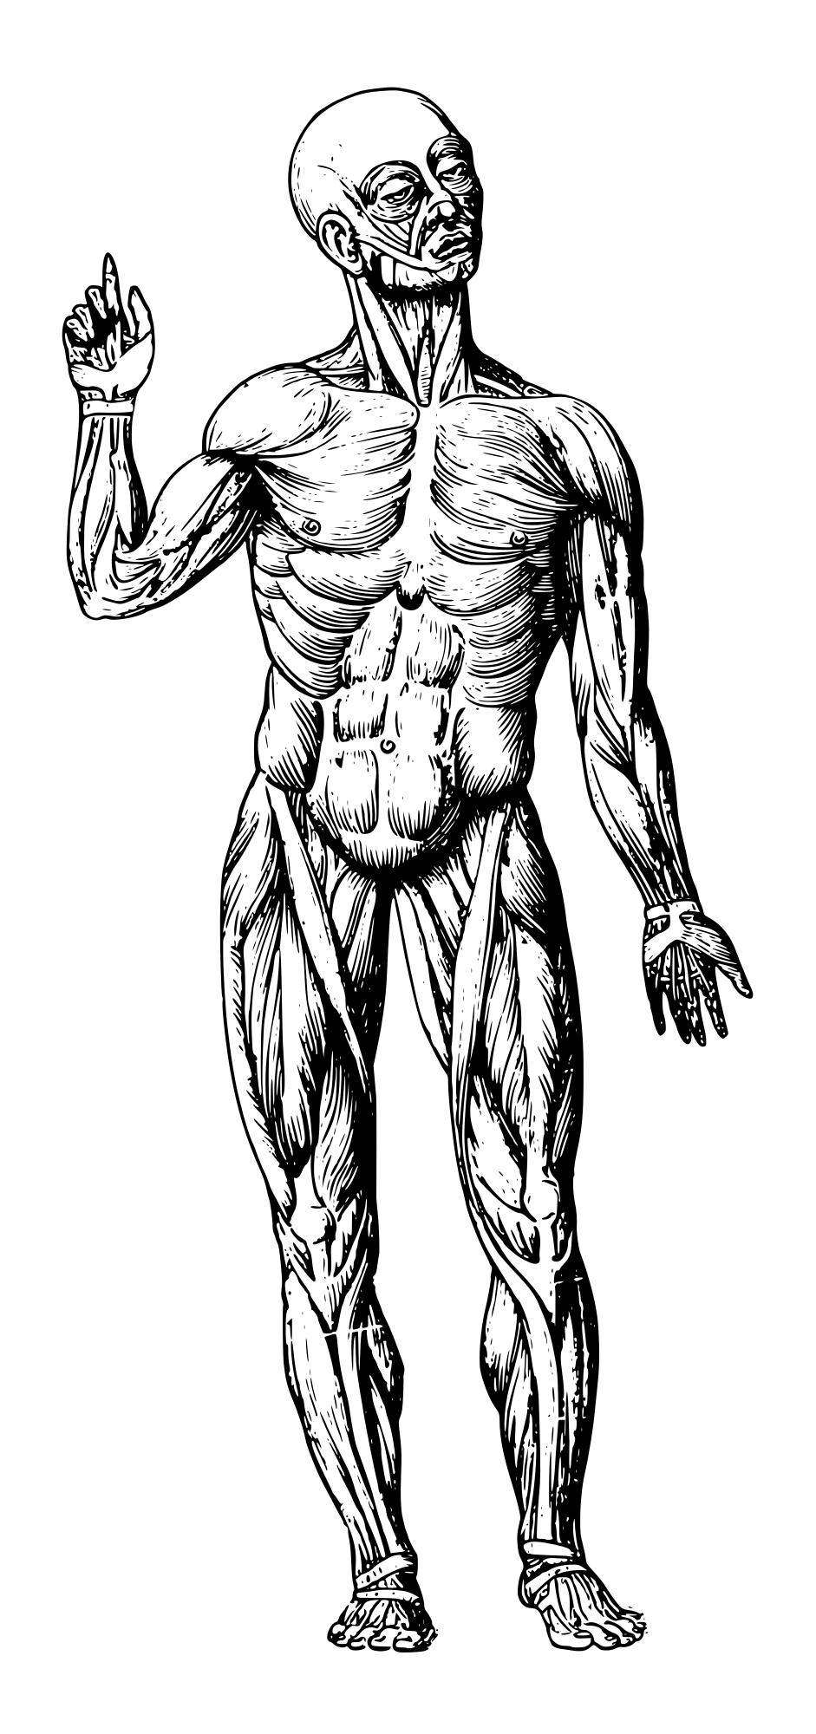

This Goofy Lad
Few things are more relatable than our own mortal existence!
Also, humans and KB agents share a depressing number of similarities.
Notes:
- Probably important to note that humans are not entirely logical, but I digress
“Human Muscle System” from https://openclipart.org/detail/326556/human-muscle-system, public domain
GIF from “SpongeBob SquarePants” Season 3 Episode 18, fair use

Slide 8
The Components of the KB Agent
Four categories of components:
Knowledge Base (KB) – Memory
Sensors – Eyes, ears, nose, skin, etc.
Actuators – Muscles, tear glands, etc.
Logic – Cognitive functions
Notes:
- How the agent knows
- What the agent does based off what it knows
- How the agent receives what it knows
- What the agent does based off what it knows
- We’ll do a broad scope overview, then go deeper
Book Chapter 7 pg. 2, 4, chapter07.pdf slide 3-4

Slide 9
The Knowledge Base
KB
The knowledge base (KB) is a set of sentences.
A sentence states an assertion or premise about the agent’s world.
These sentences are expressed in a formal language, called a knowledge representation language (KRL).
Falling in a pit = DEATH
Hugging monster = DEATH
Notes:
- The necessity of a formal language derives from the necessity of a computer to operate on logic. Though it is possible for computers to operate on imperfect sentences (see ChatGPT), we’re building from nothing here, so let’s not take the leap before building the bridge.
Book Chapter 7 pg. 2, chapter07.pdf slide 3

Slide 10
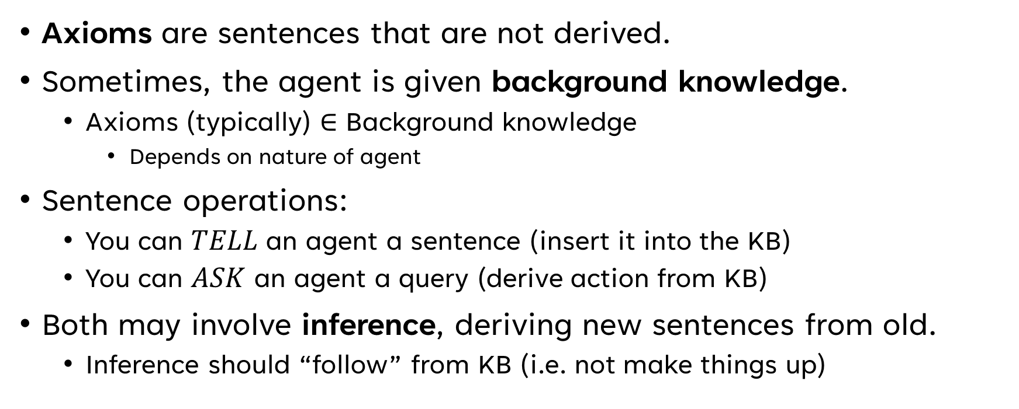
On Sentences
Axioms are sentences that are not derived.
Sometimes, the agent is given background knowledge.
Axioms (typically) ∈ Background knowledge
Depends on nature of agent
Sentence operations:
You can $TELL$ an agent a sentence (insert it into the KB)
You can $ASK$ an agent a query (derive action from KB)
Both may involve inference, deriving new sentences from old.
Inference should “follow” from KB (i.e. not make things up)
Notes:
- Axioms are fundamental, unchangeable truths
- A sentence not being derived means it is taken as being given without being derived from any pre-existing sentences.
Book Chapter 7 pg. 2, chapter07.pdf slide 3

Slide 11
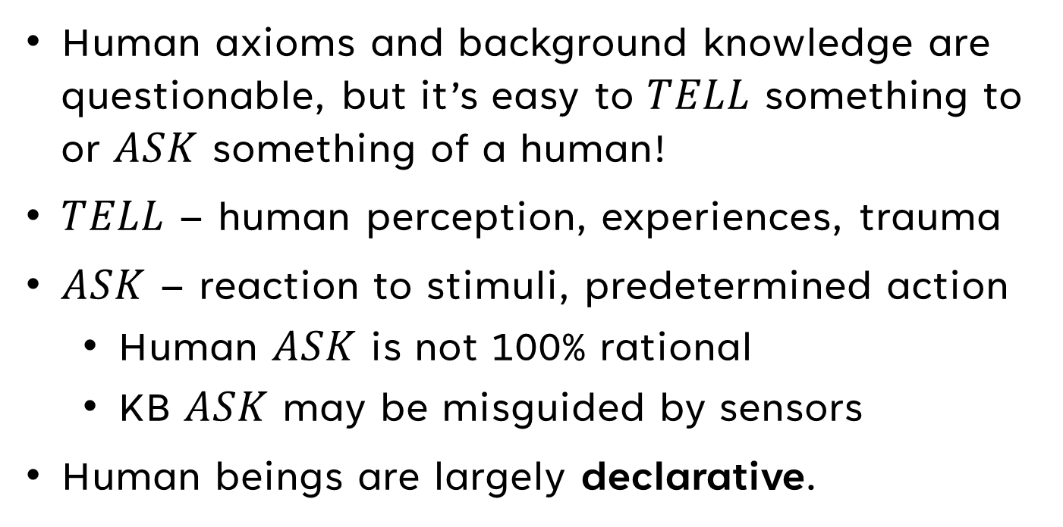
Human Sentences Operations
Human axioms and background knowledge are questionable, but it’s easy to $TELL$ something to or $ASK$ something of a human!
$TELL$ – human perception, experiences, trauma
$ASK$ – reaction to stimuli, predetermined action
Human $ASK$ is not 100% rational
KB $ASK$ may be misguided by sensors
Human beings are largely declarative.
Notes:
- Human axioms are a question of religion or philosophy
- TELLing your KB that putting your hand on a hot stove is a terrible idea
- ASKing what to do when you get punched in the face

Slide 12
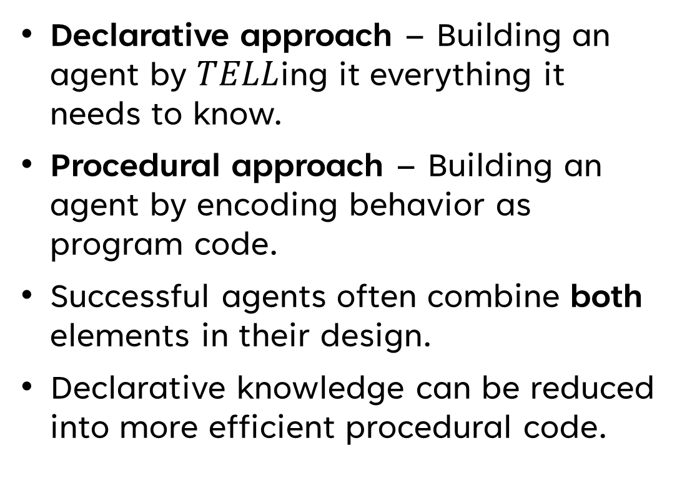
Declarative vs. Procedural
Declarative approach – Building an agent by $TELL$ing it everything it needs to know.
Procedural approach – Building an agent by encoding behavior as program code.
Successful agents often combine both elements in their design.
Declarative knowledge can be reduced into more efficient procedural code.
Declarative
To face east from north, turn right by 90 degrees
To face east from west, turn right by 180 degrees
To face east from south, turn left by 90 degrees
Procedural
function faceEast() {
if (facingNorth()) {
turnRightBy90();
} else if (facingEast()) {
…
Notes:
Chapter 7 pg. 3, chapter07.pdf slide 3

Slide 13
Perspectives on Knowledge
Knowledge level – What the agent knows, regardless of implementation.
Ex. Examinations, quizzes
Implementation level – The data structures representing the KB and the algorithms that manipulate them.
Ex. Types of memory, psychology
Parallel to design and implementation in software engineering.
Notes:
- Knowledge level says “dig the tunnel,” implementation level describes with what tools and methodologies the tunnel will be dug
- Note that with the tunnel digging analogy particularly many tragedies have been caused by screwing these things up
Book Chapter 7 pg. 3, chapter07.pdf slide 3

Slide 14
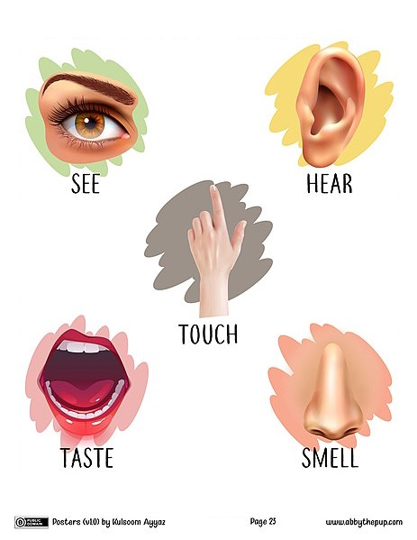
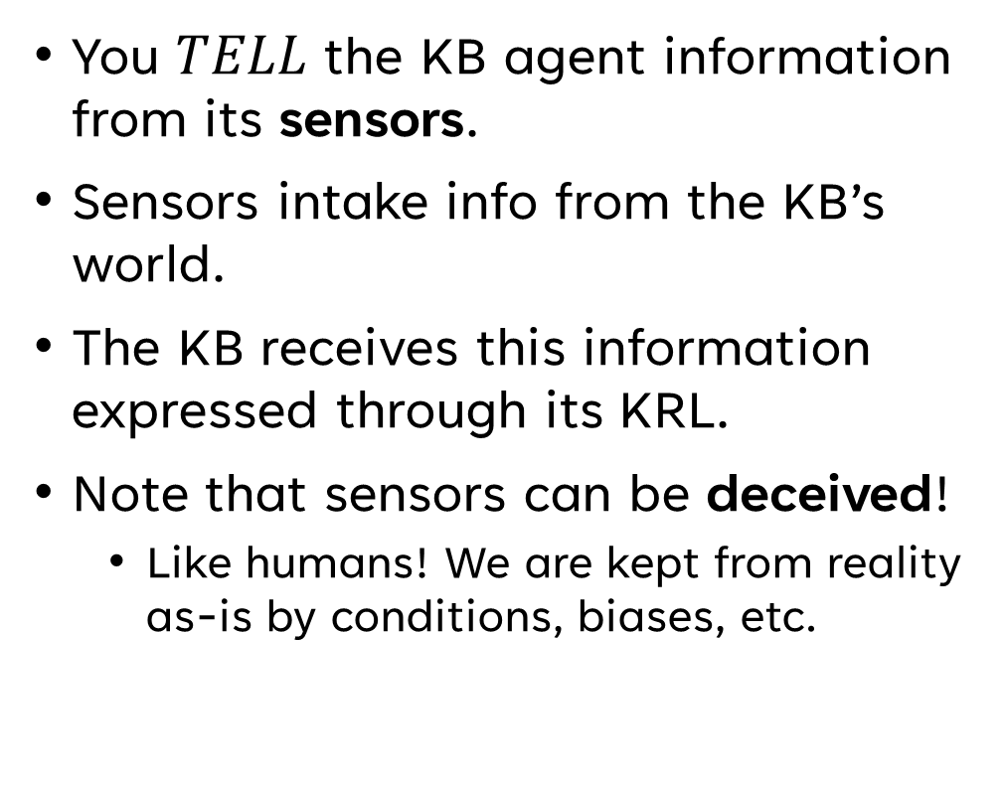
Adding to the Pile
You $TELL$ the KB agent information from its sensors.
Sensors intake info from the KB’s world.
The KB receives this information expressed through its KRL.
Note that sensors can be deceived!
Like humans! We are kept from reality as-is by conditions, biases, etc.
Notes:
- Notable that the information you TELL the KB agent is likely in addition to information not in the background knowledge.
- Recall KRL is knowledge representation language
- Color blindness, lack of senses, deceivability, trauma, etc. can contribute to false perception
Image licensed under Creative Commons Attribution-Share Alike 4.0 International (https://creativecommons.org/licenses/by-sa/4.0/deed.en ) license, retrieved from https://commons.wikimedia.org/wiki/File:My_Five_Senses_%28Abby_the_Pup%29.jpg
Book Chapter 7 pg. 4, chapter07.pdf slide 5

Slide 15
POP QUIZ!
What is a KRL?
Notes:
A KRL is a knowledge representation language.

Slide 16
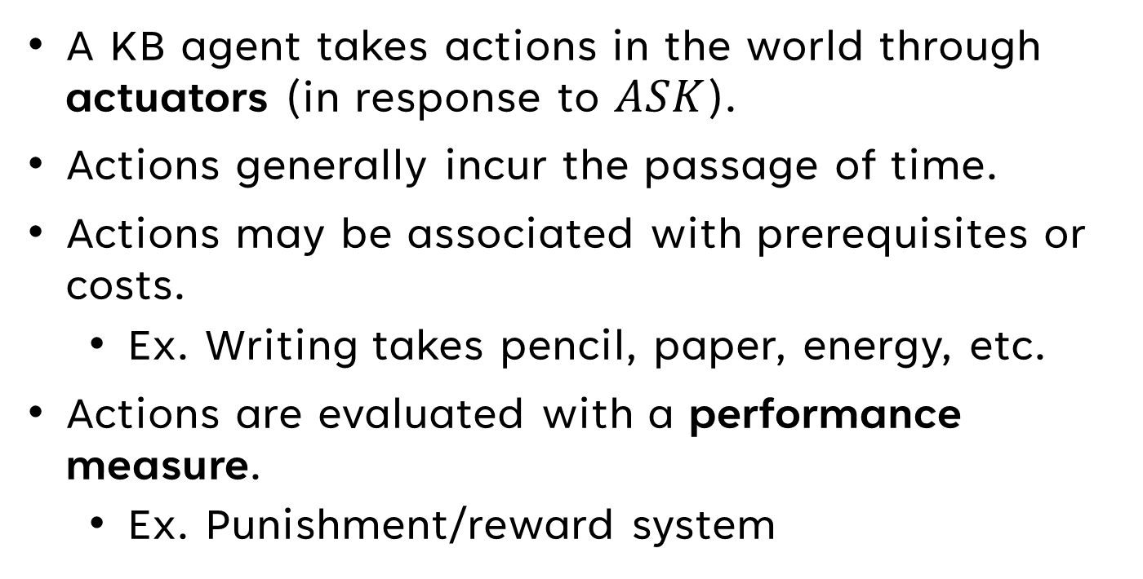
Change the World (My Final Message, Goodbye)
A KB agent takes actions in the world through actuators (in response to $ASK$).
Actions generally incur the passage of time.
Actions may be associated with prerequisites or costs.
Ex. Writing takes pencil, paper, energy, etc.
Actions are evaluated with a performance measure.
Ex. Punishment/reward system
Notes:
- In a multi-agent system, the passage of time may change the optimal action at each time interval
- A KB agent may theoretically derive an instant solve for a problem but be unable to execute it due to action cost.
- A positive performance measure generally indicates good behavior or goal accomplishment, like trophies and good grades
- A negative performance measure generally indicates bad behavior or failure, like being eaten or dying
Book Chapter 7 pg. 3-4, chapter07.pdf slide 5

Slide 17
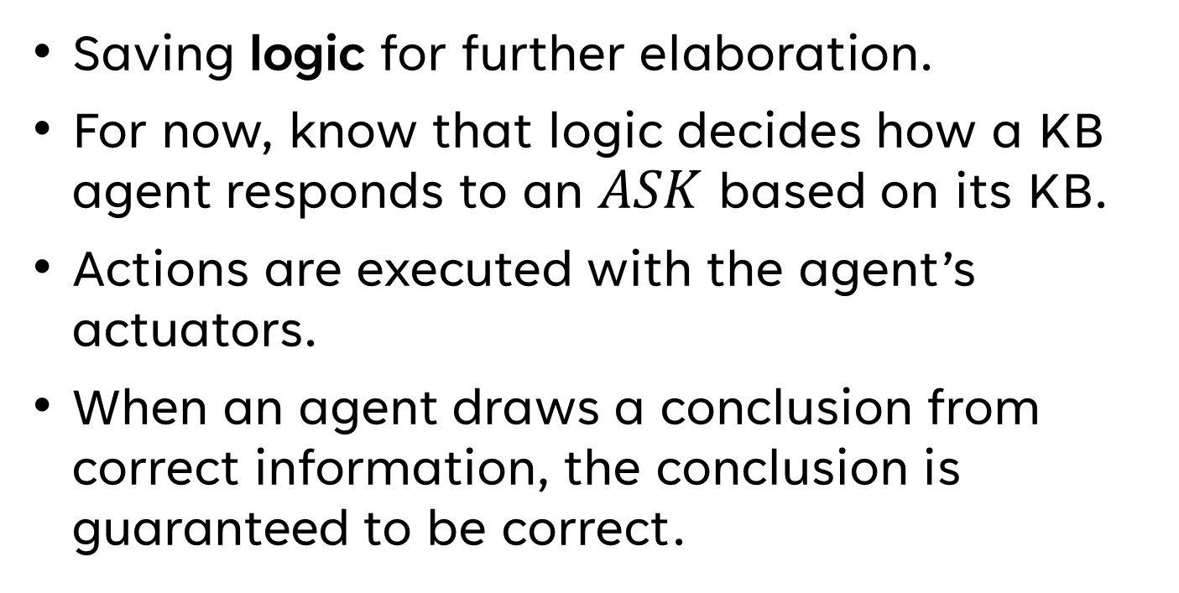
A Brief Aside on Logic
Saving logic for further elaboration.
For now, know that logic decides how a KB agent responds to an $ASK$ based on its KB.
Actions are executed with the agent’s actuators.
When an agent draws a conclusion from correct information, the conclusion is guaranteed to be correct.

Slide 18
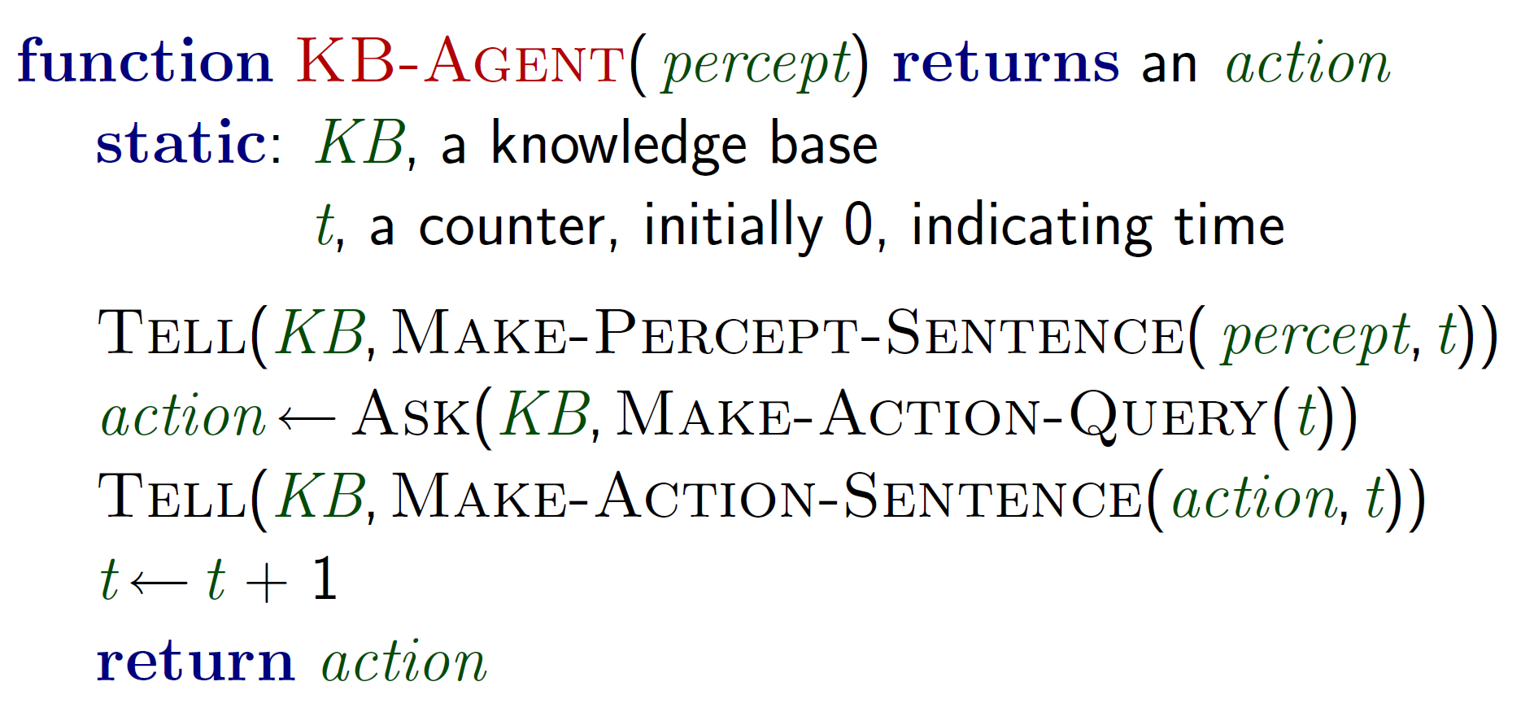
A Basic KB Agent
Notes:
ANNOTATE WHAT EACH PART OF THE ALGORITHM MAKES USE OF AND HOW IT IS FORMATTED
- Perceive from sensors
- Express the perception through the KRL
- Tell the perception to the KB
- Ask the agent to derive an action with the KB and current time
- Express that action through the KRL
- Tell the action to the KB
- Increment the time variable (passage of time)
- Return that action to be executed by the actuators
Algorithm taken from chapter07.pdf, slide 4

Slide 19
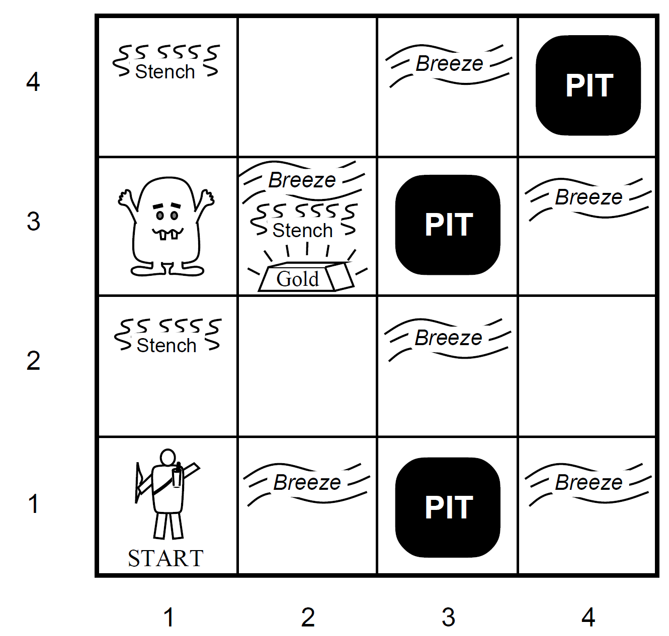

Wumpus World (Like the one from Discord?)
Performance Measure
Gold = +1,000
Step = -1
Arrow Use = -10
Death = -1,000
Actuators
Left Turn
Right Turn
Forward
Grab
Release
Shoot
Sensors
Breeze
Glitter
Smell
Environment
Squares adjacent to Wumpus are smelly
Squares adjacent to pit are breezy
Glitter iff* gold is in the same square
Shooting kills Wumpus if you are facing it
Shooting uses up the only arrow
Grabbing picks up gold if in same square
Releasing drops the gold in same square
*iff = if and only if
Will be used continually throughout this chapter!
Notes:
Chapter07.pdf slide 5, Chapter 7 pgs. 3-6

Slide 20
Characteristics of Wumpus World
​ | Answer | Explanation
Observable? | No | Only local perception. The agent can only see within one space.
Deterministic? | Yes | Outcomes exactly specified. No random chance or unpredictability involved.
Episodic? | No | Sequential at the level of actions. Each perception and action affects the next.
Static? | Yes | Wumpus and Pits (environment) do not move.
Discrete? | Yes | There are a defined number of spaces, and a defined method of navigating them.
Single-agent? | Yes | Wumpus is essentially a natural feature. No other agents take turns or actions.
Notes:
- Episodic means each “turn” perception and action is not standalone, each action affects the next, the state of the world is continuous, etc.
Chapter07.pdf slide 12

Slide 21
Questions on Wumpus World?
Notes:
- Wumpus World has been covered extensively in class, so if there are no questions on Wumpus World I will continue.

Slide 22
Logic
Thinking about thinking

Slide 23
Introduction to Logic
Logics are formal languages for representing information, such that conclusions can be drawn.
Syntax defines how sentences in the language are expressed.
Semantics define the “meaning” of sentences.
Semantics also define the truth of each sentence with respect to each possible world.
Every sentence must be either true or false (except in fuzzy logic)
Notes:
*Fuzzy logic allows for degrees of truth
Chapter07.pdf slide 22, Chapter 7 pg. 7

Slide 24
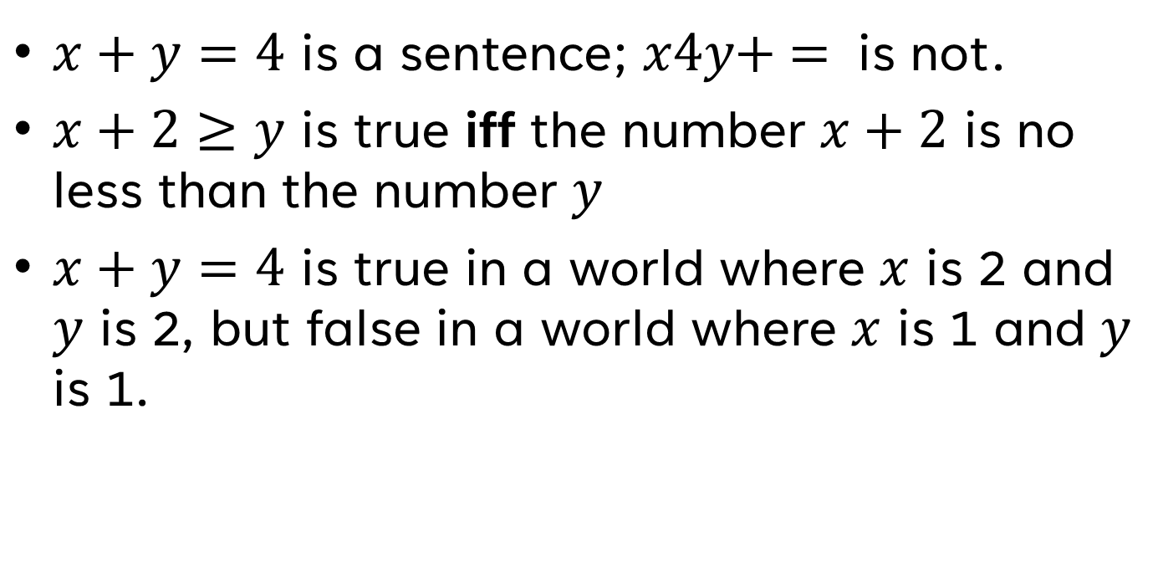
Arithmetic as a Logic Language (Fluency: Questionable)
$x+y=4$ is a sentence; $x4y+ =$ is not.
$x+2≥y$ is true iff the number $x+2$ is no less than the number $y$
$x+y=4$ is true in a world where $x$ is 2 and $y$ is 2, but false in a world where $x$ is 1 and $y$ is 1.
Notes:
Chapter07.pdf slide 22, Chapter 7 pg. 7

Slide 25
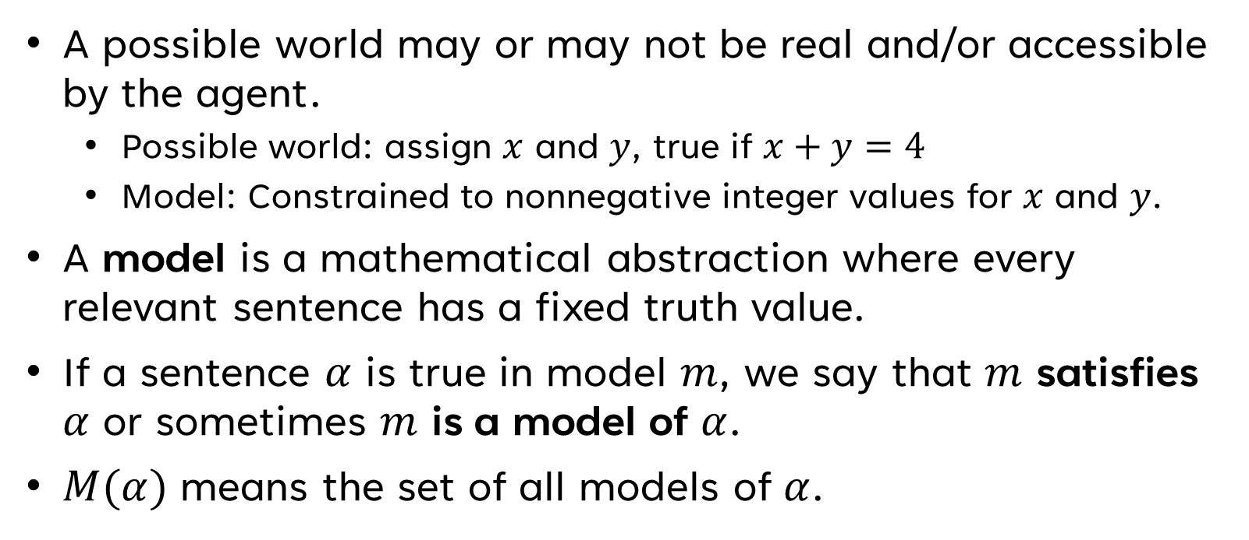
Models & Satisfaction
A possible world may or may not be real and/or accessible by the agent.
Possible world: assign $x$ and $y$, true if $x+y=4$
Model: Constrained to nonnegative integer values for $x$ and $y$.
A model is a mathematical abstraction where every relevant sentence has a fixed truth value.
If a sentence $α$ is true in model $m$, we say that $m$ satisfies $α$ or sometimes $m$ is a model of $α$.
$M(α)$ means the set of all models of $α$.
Notes:
Chapter07.pdf slide 22, Chapter 7 pg. 7

Slide 26
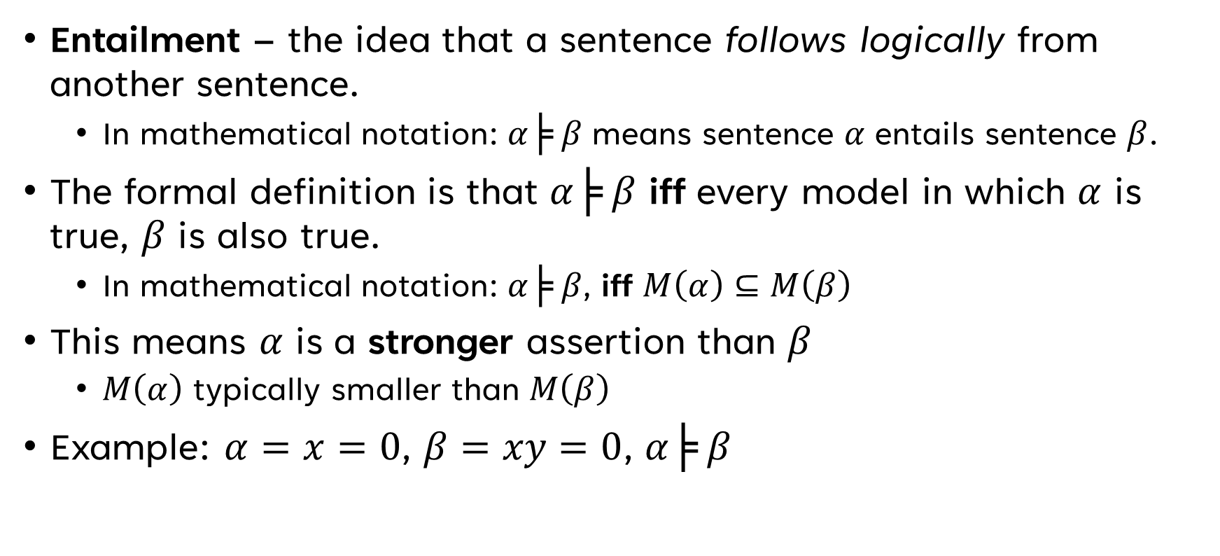
Entailment
Entailment – the idea that a sentence follows logically from another sentence.
In mathematical notation: $α╞ β$ means sentence $α$ entails sentence $β$.
The formal definition is that $α╞ β$ iff every model in which $α$ is true, $β$ is also true.
In mathematical notation: $α╞ β$, iff $M\left(α\right)⊆M\left(β\right)$
This means $α$ is a stronger assertion than $β$
$M\left(α\right)$ typically smaller than $M\left(β\right)$
Example: $α=x=0$, $β=xy=0$, $α╞ β$
Notes:
Chapter07.pdf slide 22, Chapter 7 pg. 7

Slide 27
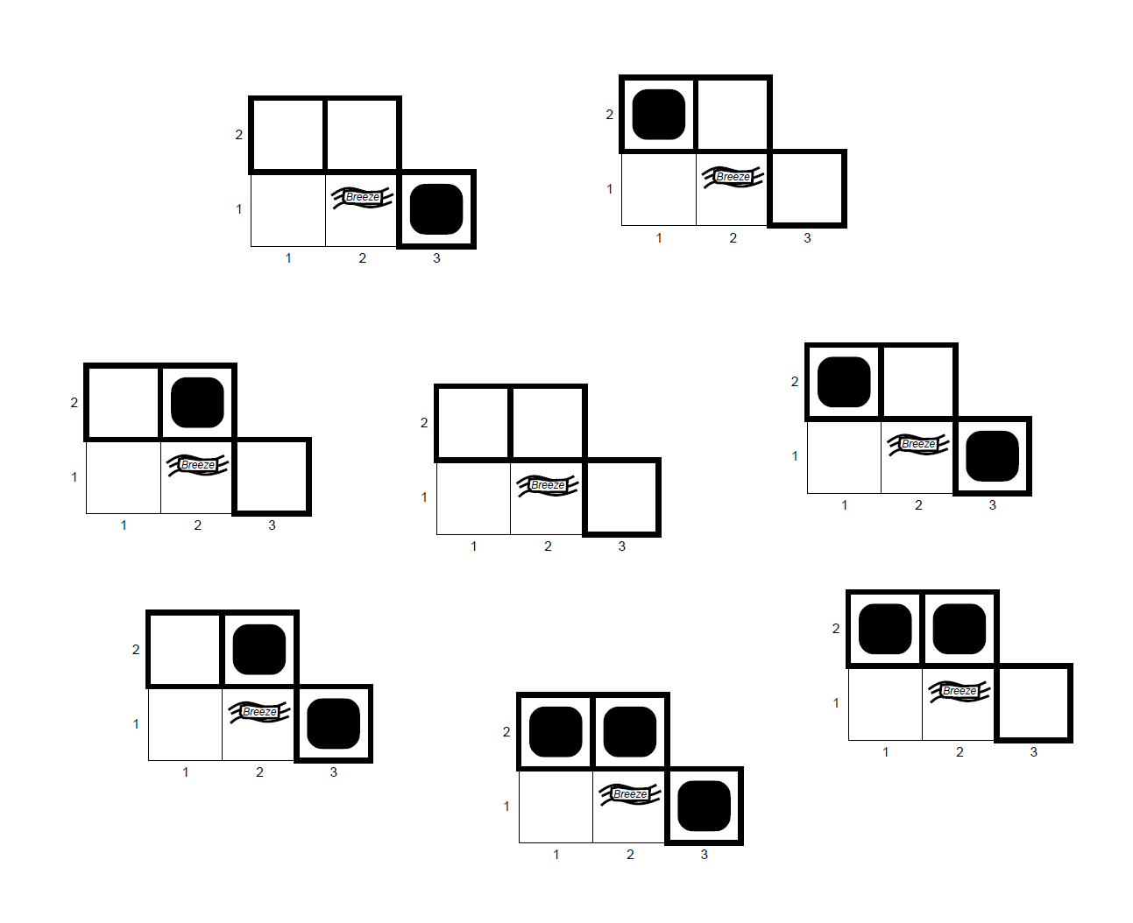
Entailment, Visualized
Notes:
Chapter07.pdf slide 26-30, Chapter 7 pg. 7-8

Slide 28
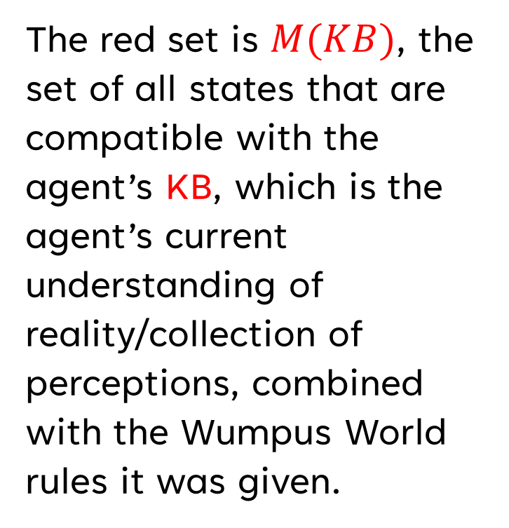
Entailment, Visualized
The red set is $M(KB)$, the set of all states that are compatible with the agent’s KB, which is the agent’s current understanding of reality/collection of perceptions, combined with the Wumpus World rules it was given.
Notes:
Chapter07.pdf slide 26-30, Chapter 7 pg. 7-8

Slide 29
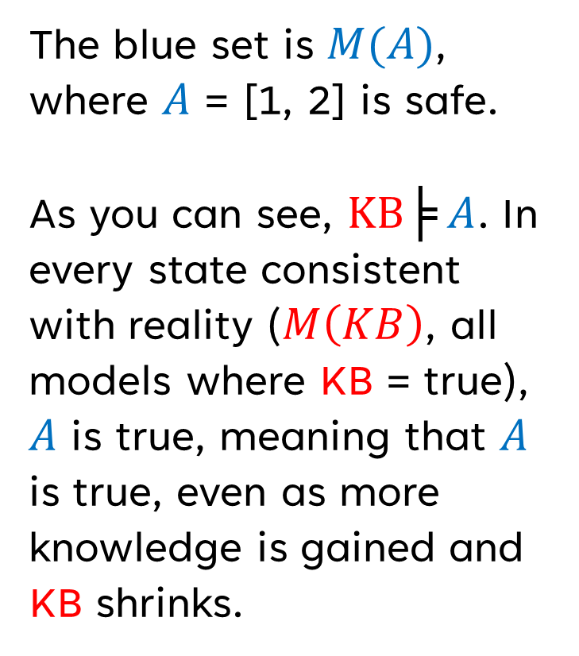
Entailment, Visualized
The blue set is $M(A)$, where $A$ = [1, 2] is safe.
As you can see, $KB╞ A$. In every state consistent with reality ($M\left(KB\right)$, all models where KB = true), $A$ is true, meaning that $A$ is true, even as more knowledge is gained and KB shrinks.
Notes:
Chapter07.pdf slide 26-30, Chapter 7 pg. 7-8

Slide 30
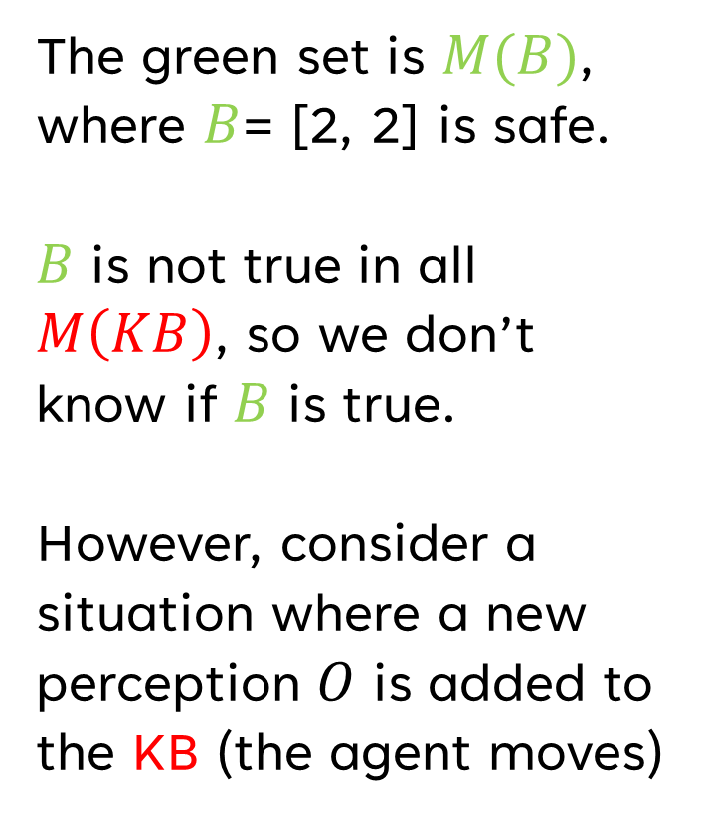
Entailment, Visualized
The green set is $M(B)$, where $B$= [2, 2] is safe.
$B$ is not true in all $M\left(KB\right)$, so we don’t know if $B$ is true.
However, consider a situation where a new perception $O$ is added to the KB (the agent moves)
Notes:
Chapter07.pdf slide 26-30, Chapter 7 pg. 7-8

Slide 31
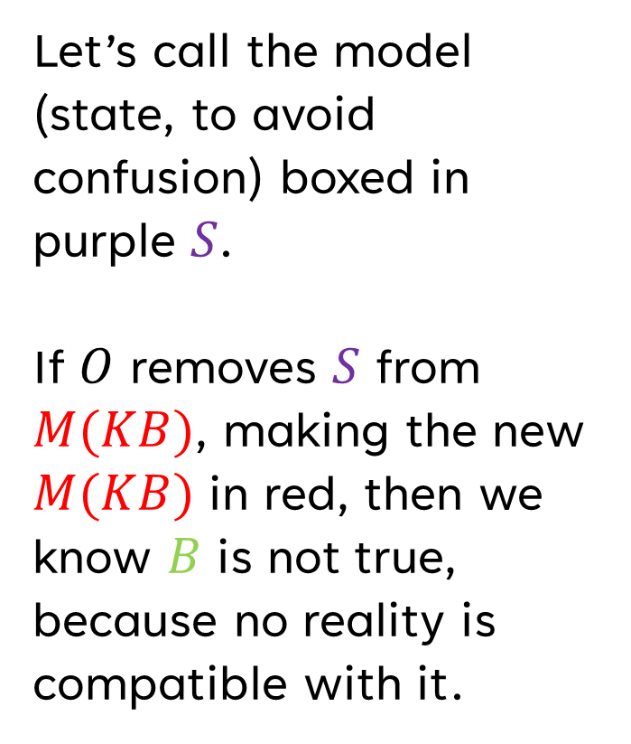
Entailment, Visualized
Let’s call the model (state, to avoid confusion) boxed in purple $S$.
If $O$ removes $S$ from $M(KB)$, making the new $M(KB)$ in red, then we know $B$ is not true, because no reality is compatible with it.
Notes:
Chapter07.pdf slide 26-30, Chapter 7 pg. 7-8

Slide 32
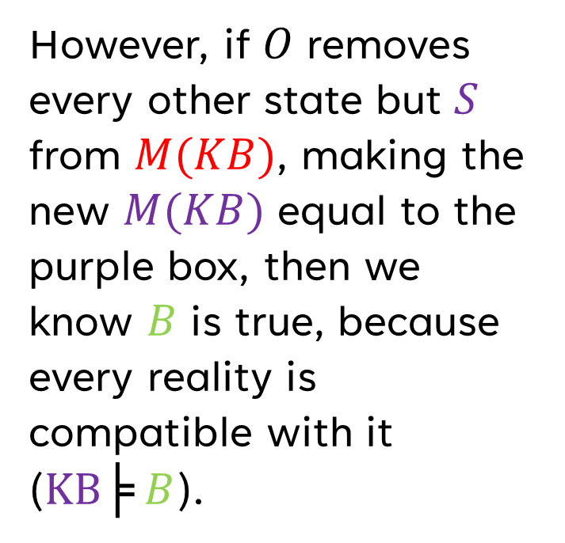
Entailment, Visualized
However, if $O$ removes every other state but $S$ from $M(KB)$, making the new $M(KB)$ equal to the purple box, then we know $B$ is true, because every reality is compatible with it ($KB╞ B$).
Notes:
Chapter07.pdf slide 26-30, Chapter 7 pg. 7-8

Slide 33
Entailment, Applied
Entailment can be applied to derive conclusions- that is, to carry out logical inference.
The prior example is called model checking, because it enumerates through all possible models to verify entailment.
Notes:
Book Chapter 7 pg. 8

Slide 34
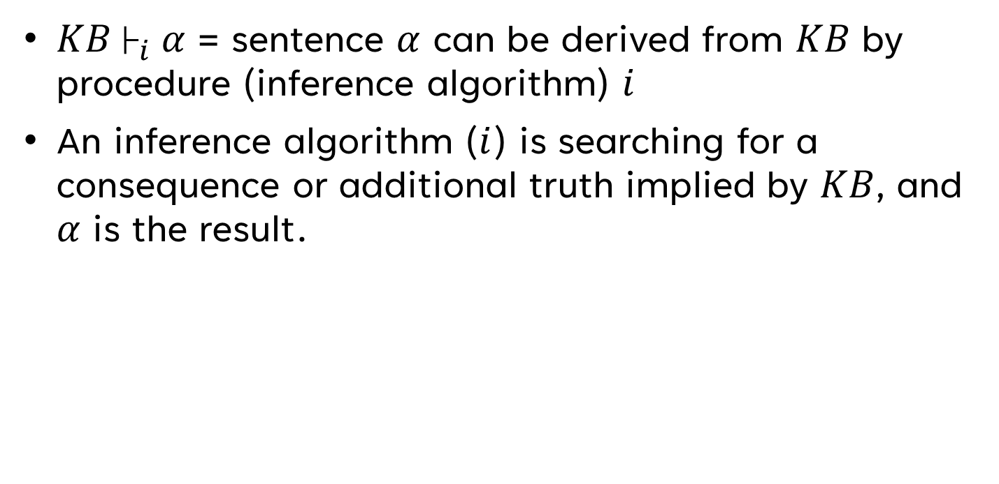
About that Inference Thing
$KB├_{i} α$ = sentence $α$ can be derived from $KB$ by procedure (inference algorithm) $i$
An inference algorithm ($i$) is searching for a consequence or additional truth implied by $KB$, and $α$ is the result.
Notes:
Book Chapter 7 pgs. 9-10, chapter07.pdf slide 31

Slide 35
Simple Inference Example
i
KB
Model Checking
Resolution
Forward or Backward Chaining
Alpha
x = 2
y = 2
2 + 2 = 4
KB fed
into i
Infers
Or proves
x + y = 4
Notes:
Book Chapter 7 pgs. 9-10, chapter07.pdf slide 31

Slide 36
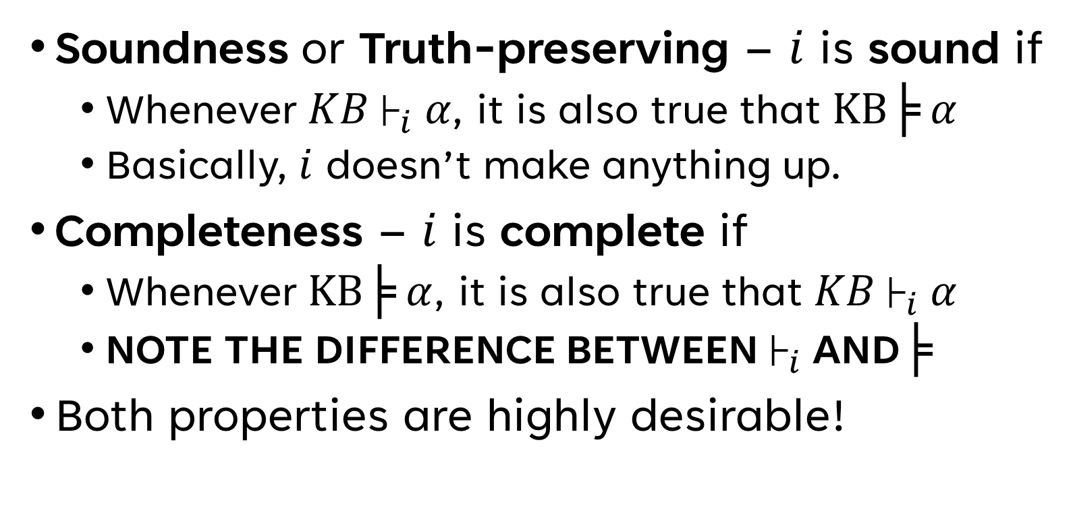
Characteristics of Inference Algorithms
Soundness or Truth-preserving – $i$ is sound if
Whenever $KB├_{i} α$, it is also true that $KB╞ α$
Basically, $i$ doesn’t make anything up.
Completeness – $i$ is complete if
Whenever $KB╞ α$, it is also true that $KB├_{i} α$
NOTE THE DIFFERENCE BETWEEN$├_{i}$ AND$╞$
Both properties are highly desirable!
Notes:
Book Chapter 7 pgs. 9-10, chapter07.pdf slide 31

Slide 37
Types of Inference Algorithms
 | Unsound | Sound
Incomplete | The algorithm may infer false sentences, and can’t infer all sentences KB entails. | The algorithm only infers true sentences, but it can’t infer all sentences KB entails.
Complete | The algorithm can infer all sentences KB entails, but it may additionally infer false sentences. | The algorithm infers only true sentences, and can infer all sentences KB entails.
Notes:
Book Chapter 7 pgs. 9-10, chapter07.pdf slide 31

Slide 38
A Final Note on KB Agents
An issues to consider is grounding.
Grounding is the connection between logical reasoning processes and the real environment in which the agent exists.
Simply: How do we know that KB is true in the real world?
The answer depends on the validity of the sensors and the process of translating perception the KB agent’s KRL.
Notes:
Book Chapter 7 pgs. 9-10

Slide 39




A Final Note on KB Agents
Even with perfect sensors and translation, a problem arises when a KB is learning.
???
Notes:
Book Chapter 7 pgs. 9-10

Slide 40
Propositional Logic
Thinking with Applied Discrete Mathematics

Slide 41
Introduction to Propositional Logic
Propositional logic is the simplest logic.
Its core unit are proposition symbols.
An atomic sentence is a sentence that contains of a single proposition symbol.
Complex sentences are constructed from simpler sentences, using parentheses and operates called logical connectives.
Notes:
- Proposition symbols are propositions that can be true or false. Typically these start with or are uppercase letters and contain other letters or subscriptions
Chapter07.pdf slide 32, Chapter 7 pg. 10

Slide 42
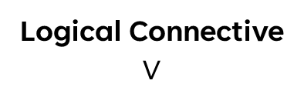

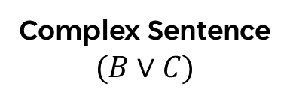

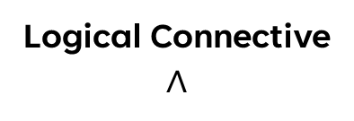


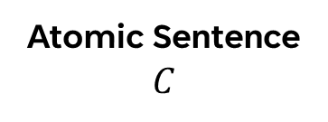
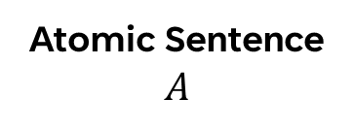
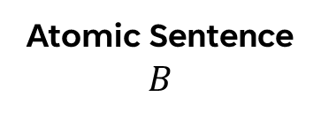
Propositional Logic Syntax
Complex Sentence
$$A∧(B∨C)$$
Atomic Sentence
$$A$$
Logical Connective
$$∧$$
Complex Sentence
$$(B∨C)$$
Proposition Symbol
$$A$$
Atomic Sentence
$$B$$
Logical Connective
$$∨$$
Atomic Sentence
$$C$$
Proposition Symbol
$$B$$
Proposition Symbol
$$C$$
Notes:
Chapter07.pdf slide 32, Chapter 7 pg. 10

Slide 43
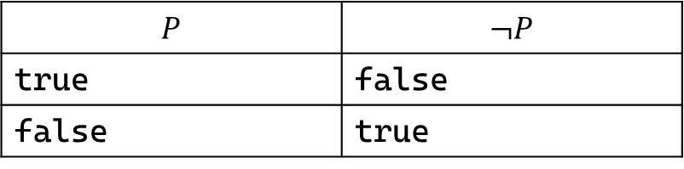
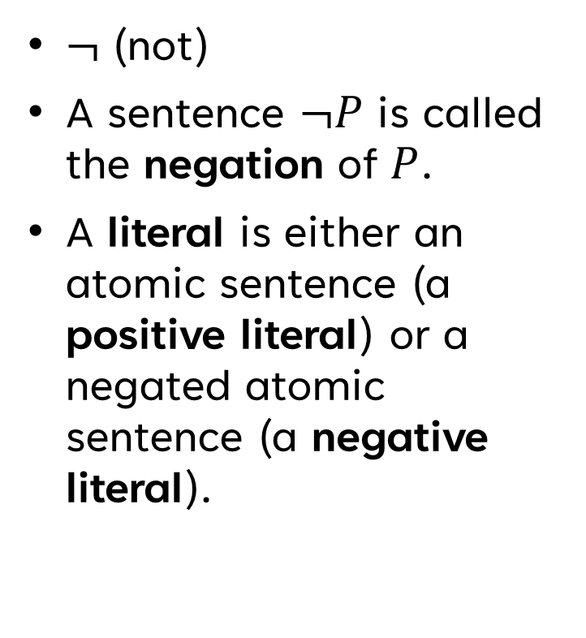
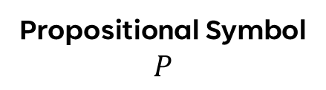

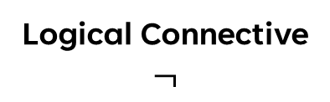
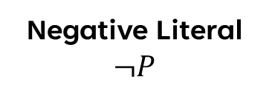
Meet the Connectives - NOT
$¬$ (not)
A sentence $¬P$ is called the negation of $P$.
A literal is either an atomic sentence (a positive literal) or a negated atomic sentence (a negative literal).
$$P$$ | $¬P$
true | false
false | true
Negative Literal
$$¬P$$
Logical Connective
$$¬$$
Atomic Sentence
$$P$$
Propositional Symbol
$$P$$
Notes:
Chapter07.pdf slide 32-34, Chapter 7 pg. 10-12

Slide 44
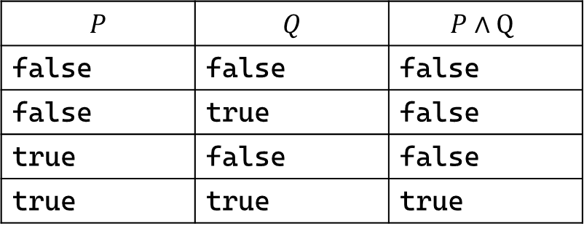
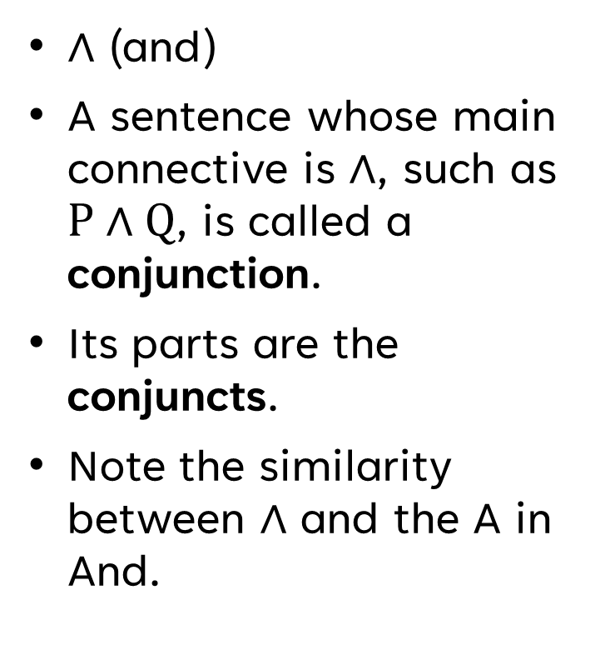

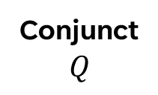


Meet the Connectives - And
$∧$ (and)
A sentence whose main connective is $∧$, such as $P∧Q$, is called a conjunction.
Its parts are the conjuncts.
Note the similarity between $∧$ and the A in And.
$$P$$ | $$Q$$ | $$P∧Q$$
false | false | false
false | true | false
true | false | false
true | true | true
Conjunction
$$P∧Q$$
Conjunct
$$P$$
Connective
$$∧$$
Conjunct
$$Q$$
Notes:
Chapter07.pdf slide 32-34, Chapter 7 pg. 10-12

Slide 45
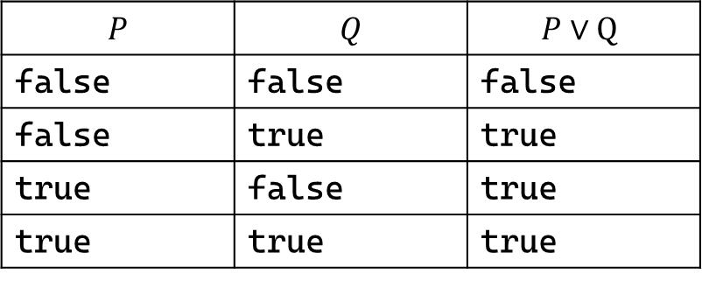
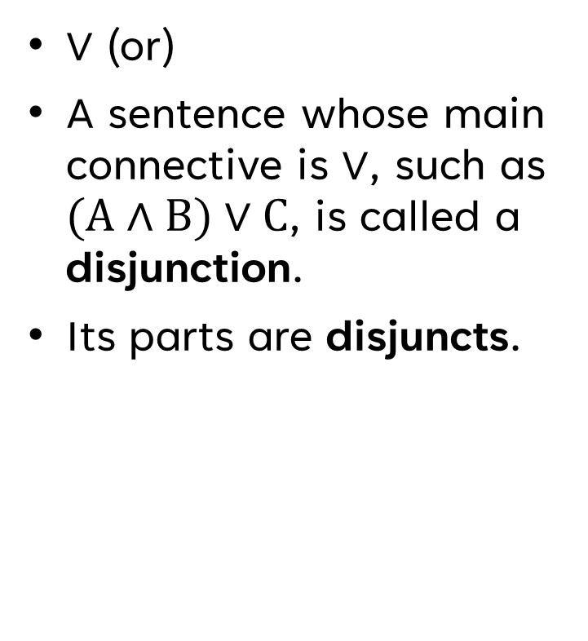

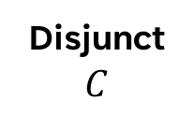
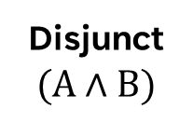
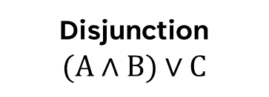
Meet the Connectives - Or
$∨$ (or)
A sentence whose main connective is $∨$, such as $(A∧B)∨C$, is called a disjunction.
Its parts are disjuncts.
$$P$$ | $$Q$$ | $$P∨Q$$
false | false | false
false | true | true
true | false | true
true | true | true
Disjunction
$$(A∧B)∨C$$
Disjunct
$$(A∧B)$$
Connective
$$∨$$
Disjunct
$$C$$
Notes:
Chapter07.pdf slide 32-34, Chapter 7 pg. 10-12

Slide 46
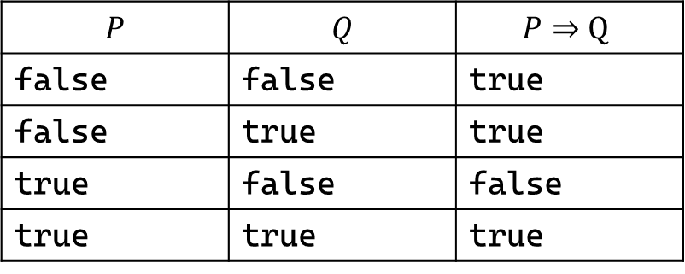
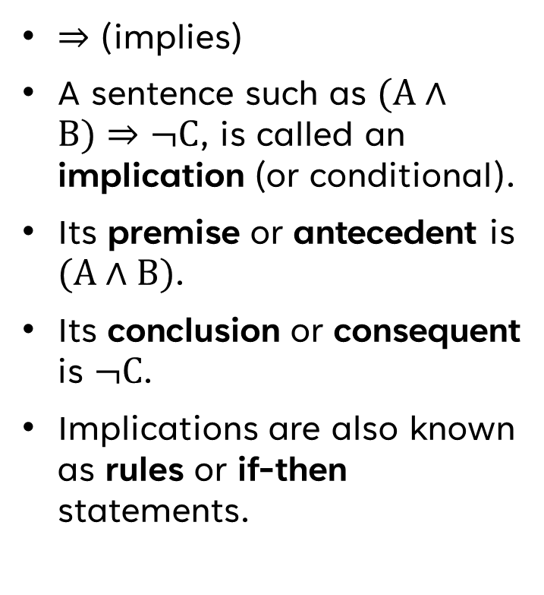
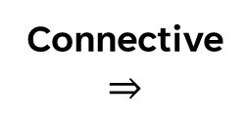

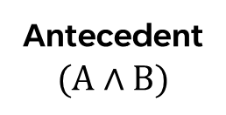
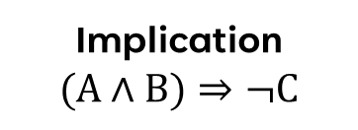
Meet the Connectives - Implies
$⇒$ (implies)
A sentence such as $(A∧B)⇒¬C$, is called an implication (or conditional).
Its premise or antecedent is $(A∧B)$.
Its conclusion or consequent is $¬C$.
Implications are also known as rules or if-then statements.
$$P$$ | $$Q$$ | $$P⇒Q$$
false | false | true
false | true | true
true | false | false
true | true | true
Implication
$$(A∧B)⇒¬C$$
Antecedent
$$(A∧B)$$
Connective
$$⇒$$
Consequent
$$¬C$$
Notes:
- This connective is only false if P is true and Q is false.
- All this connective checks for is if P is true, then is Q true?
- If P is false, we’re making no claim about implication, because something that is false can’t imply anything else
Chapter07.pdf slide 32-34, Chapter 7 pg. 10-12

Slide 47
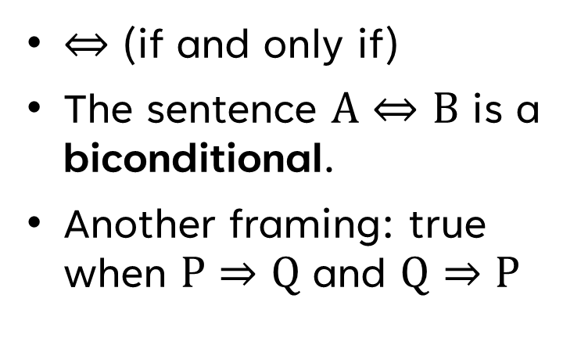
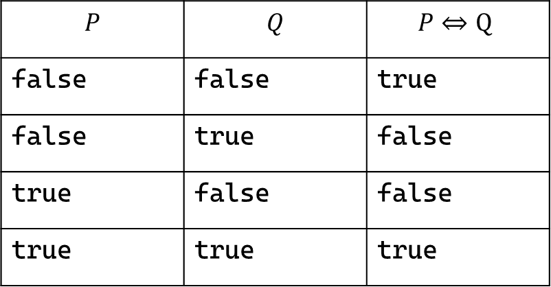
Meet the Connectives – If and Only If
$⇔$ (if and only if)
The sentence $A⇔B$ is a biconditional.
Another framing: true when $P⇒Q$ and $Q⇒P$
$$P$$ | $$Q$$ | $$P⇔Q$$
false | false | true
false | true | false
true | false | false
true | true | true
Notes:
Chapter07.pdf slide 32-34, Chapter 7 pg. 10-12

Slide 48
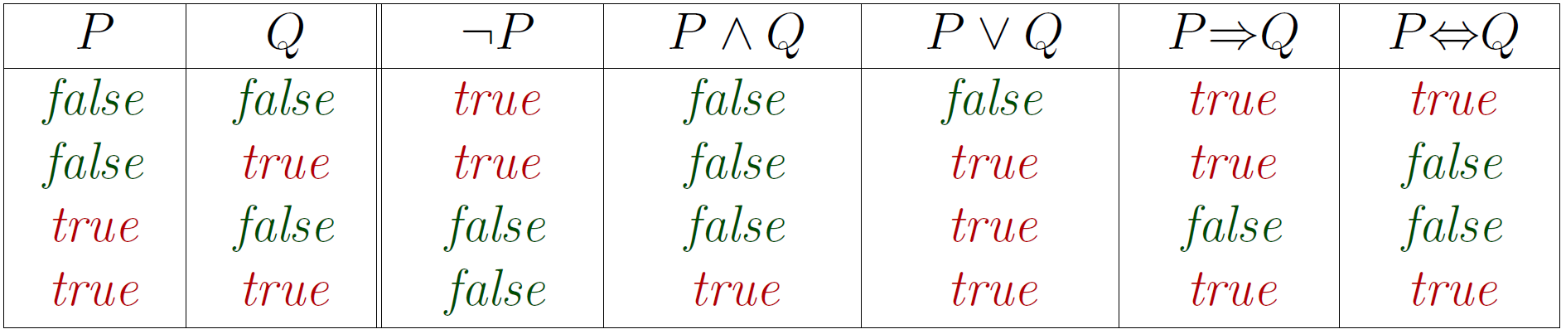
Summary of Semantics
Notes:
Chapter07.pdf slide 34

Slide 49
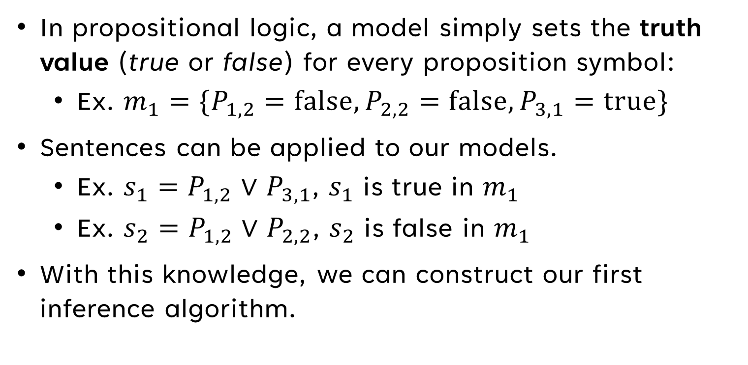
Anatomy of Models in Propositional Logic
In propositional logic, a model simply sets the truth value (true or false) for every proposition symbol:
Ex. $m_{1}=\{P_{1,2}=\text{false},P_{2,2}=\text{false},P_{3,1}=\text{true}\}$
Sentences can be applied to our models.
Ex. $s_{1}=P_{1,2}$ $∨$ $P_{3,1}$, $s_{1}$ is true in $m_{1}$
Ex. $s_{2}=P_{1,2}$ $∨$ $P_{2,2}$, $s_{2}$ is false in $m_{1}$
With this knowledge, we can construct our first inference algorithm.
Notes:
Book Chapter 7 pgs. 11, chapter07.pdf slides 33

Slide 50
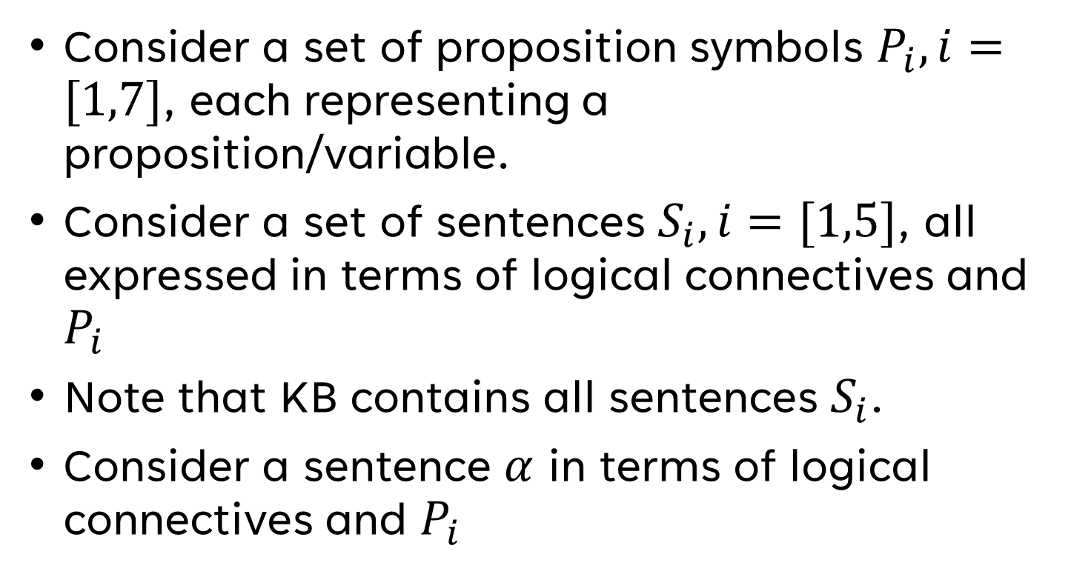
A Simple Inference Procedure
Consider a set of proposition symbols $P_{i}, i=[1,7]$, each representing a proposition/variable.
Consider a set of sentences $S_{i},i=[1,5]$, all expressed in terms of logical connectives and $P_{i}$
Note that KB contains all sentences $S_{i}$.
Consider a sentence $α$ in terms of logical connectives and $P_{i}$
Notes:
Book Chapter 7 pgs. 13-15, chapter07.pdf slides 35-38

Slide 51


Steps of TT-Entails?()
Step 1
Enumerate through all possible models.
Step 2
Test all models against KB, keeping those where KB is true.
Step 3
We check if $α$ holds for all models where KB is true.
Step 4
If $α$ holds for all models where KB is true, KB |= $α$
Notes:
- Generate all possible models, by enumerating through all possible assignments of the proposition symbols ($P_{i}$).
- We test all those models against all the sentences in KB ($S_{i}$), and collect the models where KB is true.
- We check if $α$ holds for all models where KB is true.
- If $α$ holds for all models where KB is true, KB |= $α$
Book Chapter 7 pgs. 13-15, chapter07.pdf slides 35-38

Slide 52

Truth Table for Inference
Proposition Symbols
Sentences
$$P_{1}$$ | $$P_{2}$$ | $$P_{3}$$ | $$P_{4}$$ | $$P_{5}$$ | $$P_{6}$$ | $$P_{7}$$ | $$S_{1}$$ | $$S_{2}$$ | $$S_{3}$$ | $$S_{4}$$ | $$S_{5}$$ | KB
false | false | false | false | false | false | false | true | true | true | true | false | false
false | false | false | false | false | false | true | true | true | false | true | false | false
… | … | … | … | … | … | … | … | … | … | … | … | …
false | true | false | false | false | false | false | true | true | false | true | true | false
false | true | false | false | false | false | true | true | true | true | true | true | true
false | true | false | false | false | true | false | true | true | true | true | true | true
false | true | false | false | false | true | true | true | true | true | true | true | true
false | true | false | false | true | false | false | true | false | false | true | true | false
… | … | … | … | … | … | … | … | … | … | … | … | …
true | true | true | true | true | true | true | false | true | true | false | true | false
All
Possible
Models
Notes:
- The idea is to enumerate through every possible value of P of i, and create a model from each variation
- Then, we test all of those models to see if they’re compatible with KB
- Finally, we test if Alpha is true in all the models compatible with KB
- If all of them are true, then KB entails Alpha
Book Chapter 7 pgs. 13-15, chapter07.pdf slides 35-38

Slide 53

Inference by Enumeration
This algorithm is both sound and complete.
The massive issue is that the time complexity SUCKS! $O\left(2^{n}\right)$ for $n$ propositional symbols!
Propositional entailment is co-NP-complete, so this isn’t surprising.
However, inference by enumeration makes no attempt to reduce this.
Notes:
Book Chapter 7 pgs. 13-15, chapter07.pdf slides 35-38

Slide 54
Entailment Concepts & Inference Rules
Ramping up for advanced inference algorithms

Slide 55

Tools for Theorem Proving
The next step is entailment by theorem proving – applying rules of inference directly to the sentences in our KB to prove a desired sentence without models.
Before that, we need some tools:
Logical equivalence
Validity
Satisfiability
Notes:
- Well we don’t need to settle for inference by enumeration, but before we got something better, we’re going to need to establish some tools first
Book Chapter 7 pg. 15

Slide 56


Logical Equivalence
Two sentences are logically equivalent iff true in the same models: $α≡β$ iff $α╞ β$ and $β╞ α$
This allows a variety of logical equivalences to be applied to sentences:
Notes:
Book Chapter 7 pgs. 15-16, chapter07.pdf slide 39

Slide 57

Validity & Deduction Theorem
A sentence is valid if it is true in all models. Valid sentences are also called tautologies- they are necessarily true.
Ex. $\text{True}\text{,} A∨¬A, A⇒A$
Validity is connected to the inference via the Deduction Theorem: For any sentences $α$ and $β$, $α╞ β$ if and only if the sentence $\left(α⇒β\right)$ is valid.
Notes:
Book Chapter 7 pg. 15, chapter07.pdf slide 40

Slide 58

Proving the Deduction THeorem
The green set is $M(α)$. Every model in this set must be true in $β$ (model must be in $M\left(β\right)$) for $α╞ β$. If any model in $M(α)$ is not in $M\left(β\right)$, then $α$ does not entail $β$. This logic is equivalent to $α⇒β$ if $α$ is true.
The red set are all models not in $M(α)$. If any model is in this set, it doesn’t change whether $α╞ β$. This logic is equivalent to $α⇒β$ if $α$ is false (remember, if the antecedent of an implication is false, the truth value is true).
Therefore, we have proved the equivalency of the truth tables of $α╞ β$ and $α⇒β$, proving the Deduction Theorem.
Notes:
Book Chapter 7 pg. 15, chapter07.pdf slide 40

Slide 59

Satisfiability
A sentence is satisfiable if it is true in some model.
Ex. $A∨B, C$
A sentence is unsatisfiable if it is true in no models.
Ex. $A∧¬A$
Satisfiability is connected to inference via the following:
$α╞ β$, iff $(α∧¬β)$ is unsatisfiable
This is reductio ad absurdum, also called proof by refutation or proof by contradiction.
Notes:
- The satisfiability to inference connection is most easily explained via the following: (if there is no case where a model not in $M\left(β\right)$ is in $M\left(α\right)$)
Book Chapter 7 pgs. 15-16, chapter07.pdf slides 40

Slide 60

But Wait, There’s More
Now that we’re done with entailment concepts, we must take a brief detour into inference rules.
One applies inference rules to derive a proof- a chain of conclusions that leads to the desired goal.
These rules are expressed in the following notation:
$$\frac{\text{sentenceOne}\text{, }\text{sentenceTwo}}{\text{sentenceThree}}$$
If sentenceOne and sentenceTwo are true, then sentenceThree is true (inferred).
Notes:
- Note that sentenceTwo is optional
Book Chapter 7 pg. 16-18

Slide 61


Well-Known Inference Rules
Modus Ponens
$$\frac{α⇒β\text{, } α }{β}$$
And-Elimination
$$\frac{α∧β}{α}$$
Notes:
Book Chapter 7 pg. 16-18

Slide 62

Additional Proofs Practice
Notes:
- Revisit later if you want further exercise with proofs
Book Chapter 7 pg. 17

Slide 63
Advanced Inference Algorithms
Literally the Dark Souls of inference

Slide 64

Categorization of Inference Algorithms
Inference algorithms divide into (roughly) two broad categories:
Application of Inference Rules
Sound generation of new sentences from old
Requires proofs = sequences of inference rule applications
Typically requires translation of sentences into a normal form
New algorithms: Resolution, forward and backward chaining, etc.
Model Checking
Truth table enumeration (always exponential in $n$)
New algorithms: Improved backtracking, such as DPLL, etc.
Notes:
Book Chapter 7 pgs. 18-28, chapter07.pdf slides 41-71

Slide 65

Horn Form
Before we get into forward and backward chaining, we have to establish Horn Form.
Horn Form = KB = conjunction of Horn clauses
Horn Clause =
Proposition symbol (called a fact) or
(conjunction of symbols (called the body)) $⇒$ (symbol (called the head))
Not all logical sentences can be expressed as horn form!
Notes:
Book Chapter 7 pgs. 22-23, chapter07.pdf slides 42

Slide 66








Horn Form Syntax
Horn Form
$$C∧(B⇒A)∧(C∧D⇒B)$$
Horn Clause
$$C$$
Horn Clause
$$(B⇒A)$$
Horn Clause
$$(C∧D⇒B)$$
Conjunction of Symbols
$$B$$
Symbol
$$A$$
Conjunction of Symbols
$$C∧D$$
Symbol
$$B$$
Notes:
- Label the facts, bodies, and heads
- hungry hungry caterpillar analogy with the head and the body, since the body can be long and the head is always one symbol
Book Chapter 7 pgs. 22-23, chapter07.pdf slides 42

Slide 67
POP QUIZ!
Can a Horn clause be represented with any other connectives?
Notes:
Yes!

Slide 68



Alternate Horn Clause Expression
Original Expression
Implication Elimination
Implication Elimination
De Morgan
$C∧(B⇒A)∧(C∧D⇒B)$
$C∧(¬B∨A)∧(C∧D⇒B)$
$C∧(¬B∨A)∧(¬(C∧D)∨B)$
$C∧(¬B∨A)∧( ¬C∨¬D∨B)$
Implication Elimination
$$α⇒β≡(¬α∨β)$$
De Morgan
$$¬(α∧β)≡(¬α∨¬β)$$
Notes:
- Note that in most other books and literature, this is primarily how the Horn Clause is presented.
- Note all clauses in this CNF are definite clauses (a disjunction of literals where exactly one is positive).
- Horn clauses have one positive literal at most.
Book Chapter 7 pg. 16

Slide 69


Breaking out the Toolbox
Modus Ponens (for Horn Form)
$$\frac{α_{1},…,α_{n}, α_{1}∧…∧α_{n}⇒β}{β}$$
Remember Modus Pones? Now, we have an application that is complete for KBs in Horn Form.
Can be used with forward chaining or backward chaining.
Runs in linear time.
Alternative Perspective…
$$KB=\{S_{1}∧…∧S_{n}\}$$
$$\frac{KB, KB⇒β}{β}$$
Notes:
- All this means is that if a set of sentences are true, and that set of sentences implies the sentence Beta, then Beta is true
Book Chapter 7 pgs. 22-23, chapter07.pdf slides 42

Slide 70
Forward Chaining
Forward chaining (FC) determines if a single proposition symbol q is entailed by a knowledge base of definite clauses*.
Query is not a sentence, it’s a symbol!
It starts from known facts (positive literals) in the knowledge base.
Premise: Proving a symbol is true in the KB by starting with true symbols and traversing the horn clauses that use them!
Notes:
*definite clauses, a disjunction of literals of which exactly one is positive, whereas a horn clause has at MOST one positive, so a horn clause is more flexible than a definite clause
Book Chapter 7 pgs. 22-25, chapter07.pdf slides 43-53

Slide 71

Forward Chaining Psuedocode
Notes:
Recall that every sentence in this KB is an implication or a positive literal because it is in Horn Form, so all the sentences are Horn clauses. So, the premise is the conjunction of symbols that are the body of the horn clause, and the conclusion of is the single propositional symbol that is the head of the horn clause.
Every clause in the KB is assigned a counter, where the counter is the number of symbols in the premise of the clause. For that premise to be proven true, the counter needs to be reduced to 0. If it doesn’t, that means that either a literal which is supposed to be positive is not (massive issue), or we haven’t processed all of the symbols in its premise yet.
So, we loop through every symbol in the KB, visiting every symbol only once, and reduce the count of any clause that has this symbol in its premise.
For any clause that has its count reduced to 0 (meaning it has been proven true), then we check if its head is our goal, because if it is, then our goal has been proven true and we can add it to the KB.
If not, we add the head, or the conclusion of that clause to the queue of symbols to visit.
Book Chapter 7 pgs. 24, chapter07.pdf slide 44

Slide 72

Forward Chaining Walkthrough
Notes:
Starting literal queue: A & B
Starting counts:
- A AND P = 2
- A AND B = 2
- B AND L = 2
- M AND L = 2
- P = 1
Diagram given on chapter07.pdf 43
Book Chapter 7 pgs. 22-25, chapter07.pdf slides 43-53

Slide 73

Forward Chaining – Proof of Completeness
FC derives every atomic sentence entailed by KB.
FC reaches a fixed point where no new atomic sentences are derived.
Consider the final state as a model m, assigning truth values to symbols.
Every clause in the original KB is true in m.
Hence m is a model of KB.
If $KB╞ q$, $q$ is true in every model of KB, including m.
General idea: Construct any model of KB by sound inference, check $α$
Notes:
chapter07.pdf slide 53

Slide 74
Backward Chaining
Backward chaining (BC) is like FC, but it works backwards from q instead of starting from positive literals.
First, BC checks if q is known already. If so, it stops, as it has succeeded.
If q is not known, prove all premises of some clause concluding with q.
BC remembers clauses that have already been visited and will be visited to avoid repetition and loops.
Notes:
Book Chapter 7 pgs. 24-25, chapter07.pdf slides 54-65

Slide 75
Backward Chaining Walkthrough
Notes:
Will probably need to reference chapter07.pdf for this
Book Chapter 7 pgs. 24-25, chapter07.pdf slides 54-65

Slide 76
Forward vs. Backward Chaining
Both are linear time complexity, though BC can be much less than linear in size of KB.
This is because BC is goal-driven, focused on answering specific questions.
FC, on the other hand, is data-driven. It is automatic, unconscious processing, and may do lots of work irrelevant to the goal.
Notes:
Book Chapter 7 pgs. 23-25, chapter07.pdf slides 42-66

Slide 77

Resolution
Resolution is an inference rule and algorithm.
Intakes sentences in Conjunctive Normal Form (CNF).
A conjunction of (disjunctions of literals)
Ex. $(A∨¬B)∧(B∨¬C∨¬D)$
The resolution inference rule for CNF is as follows:
$\frac{α_{1}∨…∨α_{k}, β_{1}∨…∨β_{n}}{α_{1}∨…∨α_{i−1}∨α_{i+1}∨…∨α_{k}∨β_{1}∨…∨β_{j−1}∨β_{j+1}∨…∨β_{n}}$ where $α_{i}$ and $β_{j}$ are complementary literals.
Example:
$\frac{\left(A∨B∨C\right), (D∨¬B,F)}{A∨C∨D∨F}$
Notes:
Chapter07.pdf slide 67

Slide 78

Resolution Algorithm
Notes:
Chapter07.pdf slide 69

Slide 79

DPLL
Notes:
Psuedocode retrieved from Wikipedia on February 19, 2024: https://en.wikipedia.org/wiki/DPLL_algorithm

Slide 80
THANK YOU
Joshua Sheldon
jsheldon2022@my.fit.edu

